Slide 1
Genetic Algorithms

Slide 2
GA Quick Overview
Developed: USA in the 1970’s
Early names: J. Holland, K. DeJong, D. Goldberg
A genetic algorithm (or GA) is a search technique used in computing to find true or approximate solutions to optimization and search problems.
Genetic algorithms are categorized as global search heuristics.
Genetic algorithms are a particular class of evolutionary algorithms that use techniques inspired by evolutionary biology such as inheritance, mutation, selection, and crossover (also called recombination).

Slide 3
GA Quick Overview
Typically applied to:
  discrete optimization
Attributed features:
  not too fast
  good heuristic for combinatorial problems
Special Features:
  Traditionally emphasizes combining information from good parents (crossover)
  many variants, e.g., reproduction models, operators

Slide 4
Genetic algorithms
Holland’s original GA is now known as the simple genetic algorithm (SGA)
Other GAs use different:
  Representations
  Mutations
  Crossovers
  Selection mechanisms

Slide 5
What is GA
Genetic algorithms are implemented as a computer simulation in which a population of abstract representations (called chromosomes or the genotype or the genome) of candidate solutions (called individuals, creatures, or phenotypes) to an optimization problem evolves toward better solutions.
Traditionally, solutions are represented in binary as strings of 0s and 1s, but other encodings are also possible.

Slide 6
What is GA
The evolution usually starts from a population of randomly generated individuals and happens in generations.
In each generation, the fitness of every individual in the population is evaluated, multiple individuals are selected from the current population (based on their fitness), and modified (recombined and possibly mutated) to form a new population.

Slide 7
What is GA
The new population is then used in the next iteration of the algorithm.
Commonly, the algorithm terminates when either a maximum number of generations has been produced, or a satisfactory fitness level has been reached for the population.
If the algorithm has terminated due to a maximum number of generations, a satisfactory solution may or may not have been reached.

Slide 8
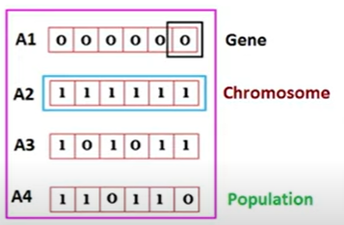
Key terms
Individual - Any possible solution
Population - Group of all individuals
Search Space - All possible solutions to the problem
Chromosome - Blueprint for an individual
Trait/Gene - Possible aspect (features) of an individual

Slide 9
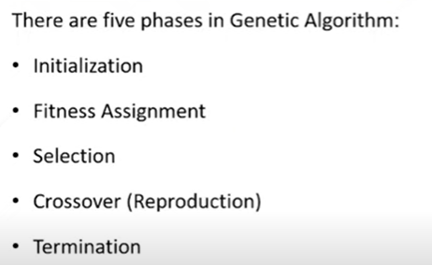
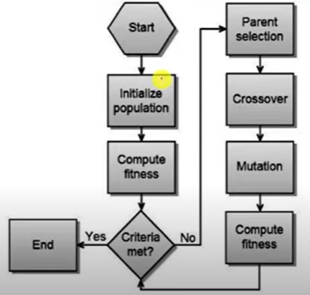
Phases of GA

Slide 10
SGA technical summary tableau
Representation | Binary strings
Recombination | N-point or uniform
Mutation | Bitwise bit-flipping with fixed probability
Parent selection | Fitness-Proportionate
Survivor selection | All children replace parents
Speciality | Emphasis on crossover

Slide 11
Representation
Phenotype space
Genotype space = {0,1}^{L}
Encoding
(representation)
10010001
10010010
010001001
011101001
Decoding
(inverse representation)

Slide 12
SGA reproduction cycle
Select parents for the mating pool
(size of mating pool = population size)
Shuffle the mating pool
For each consecutive pair apply crossover with probability p_{c} , otherwise copy parents
For each offspring apply mutation (bit-flip with probability p_{m} independently for each bit)
Replace the whole population with the resulting offspring

Slide 13
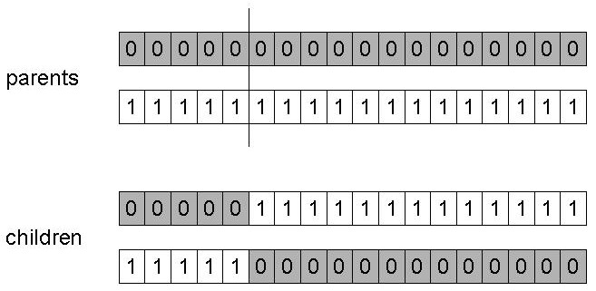
SGA operators: 1-point crossover
Choose a random point on the two parents
Split parents at this crossover point
Create children by exchanging tails
P_{c} typically in range (0.6, 0.9)

Slide 14
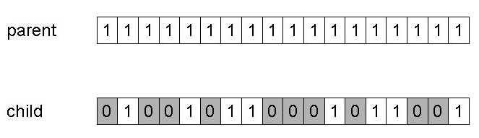
SGA operators: mutation
Alter each gene independently with a probability p_{m}
p_{m} is called the mutation rate
  Typically between 1/pop_size and 1/ chromosome_length

Slide 15
SGA operators: Selection
Main idea: better individuals get higher chance
  Chances proportional to fitness
  Implementation: roulette wheel technique
        Assign to each individual a part of the roulette wheel
        Spin the wheel n times to select n individuals
1/6 = 17%
B
fitness(A) = 3
A
C
fitness(B) = 1
3/6 = 50%
2/6 = 33%
fitness(C) = 2

Slide 16
An example after Goldberg ‘89 (1)
Simple problem: max x² over {0,1,…,31}
GA approach:
  Representation: binary code, e.g. 01101 ↔ 13
  Population size: 4
  1-point xover, bitwise mutation
  Roulette wheel selection
  Random initialisation
We show one generational cycle done by hand

Slide 17
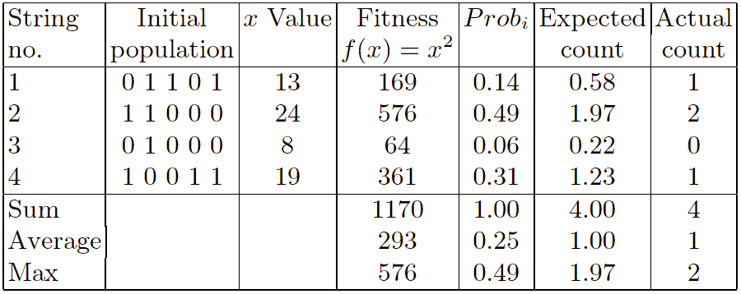


x² example: selection

Slide 18
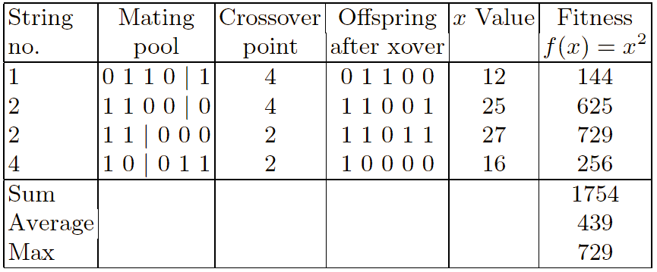
X² example: crossover

Slide 19
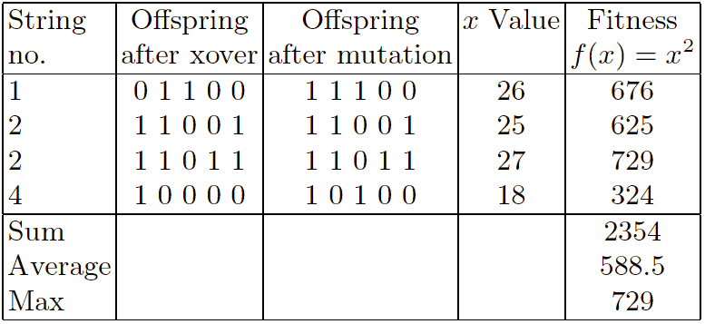
X² example: mutation

Slide 20
The simple GA
Has been subject of many (early) studies
  still often used as benchmark for novel GAs
Shows many shortcomings, e.g.
  Representation is too restrictive
  Mutation & crossovers only applicable for bit-string & integer representations
  Selection mechanism sensitive for converging populations with close fitness values
  Generational population model (step 5 in SGA repr. cycle) can be improved with explicit survivor selection

Slide 21
Alternative Crossover Operators
Performance with 1 Point Crossover depends on the order that variables occur in the representation
  more likely to keep together genes that are near each other
  Can never keep together genes from opposite ends of string
  This is known as Positional Bias
  Can be exploited if we know about the structure of our problem, but this is not usually the case

Slide 22
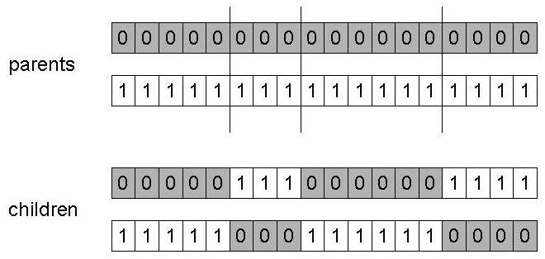
n-point crossover
Choose n random crossover points
Split along those points
Glue parts, alternating between parents
Generalisation of 1 point (still some positional bias)

Slide 23
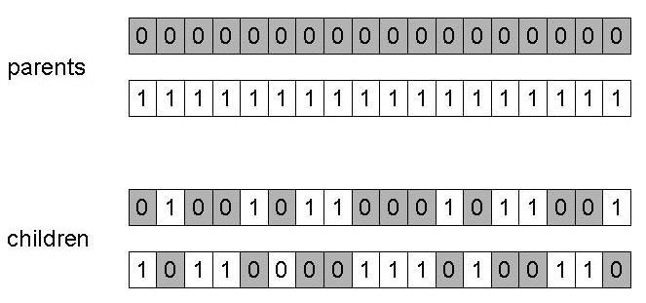
Uniform crossover
Assign 'heads' to one parent, 'tails' to the other
Flip a coin for each gene of the first child
Make an inverse copy of the gene for the second child
Inheritance is independent of position

Slide 24
Crossover OR mutation?
Decade long debate: which one is better / necessary / main-background
Answer (at least, rather wide agreement):
  it depends on the problem, but
  in general, it is good to have both
  both have another role
  mutation-only-EA is possible, xover-only-EA would not work

Slide 25
Crossover OR mutation? (cont’d)
Exploration: Discovering promising areas in the search space, i.e. gaining information on the problem
Exploitation: Optimising within a promising area, i.e. using information
There is co-operation AND competition between them
Crossover is explorative, it makes a big jump to an area somewhere “in between” two (parent) areas
Mutation is exploitative, it creates random small diversions, thereby staying near (in the area of ) the parent

Slide 26
Crossover OR mutation? (cont’d)
Only crossover can combine information from two parents
Only mutation can introduce new information (alleles)
Crossover does not change the allele frequencies of the population (thought experiment: 50% 0’s on first bit in the population, ?% after performing n crossovers)
To hit the optimum you often need a ‘lucky’ mutation

Slide 27
Other representations
Gray coding of integers (still binary chromosomes)
  Gray coding is a mapping that means that small changes in the genotype cause small changes in the phenotype (unlike binary coding). “Smoother” genotype-phenotype mapping makes life easier for the GA
Nowadays it is generally accepted that it is better to encode numerical variables directly as
Integers
Floating point variables

Slide 28
Integer representations
Some problems naturally have integer variables, e.g. image processing parameters
Others take categorical values from a fixed set e.g. {blue, green, yellow, pink}
N-point / uniform crossover operators work
Extend bit-flipping mutation to make
  “creep” i.e. more likely to move to similar value
  Random choice (esp. categorical variables)
  For ordinal problems, it is hard to know correct range for creep, so often use two mutation operators in tandem

Slide 29
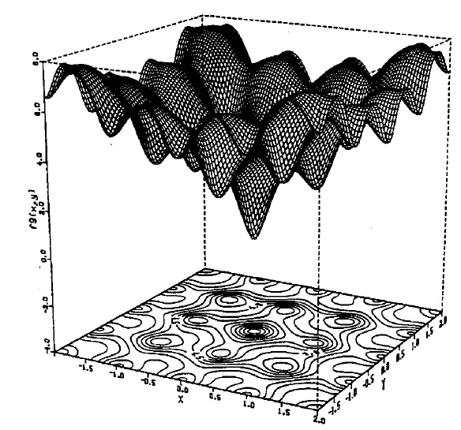
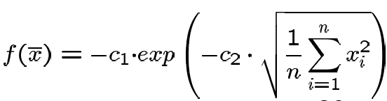

Real valued problems
Many problems occur as real valued problems, e.g. continuous parameter optimisation f : ℜ ^{n} → ℜ
Illustration: Ackley’s function (often used in EC)

Slide 30
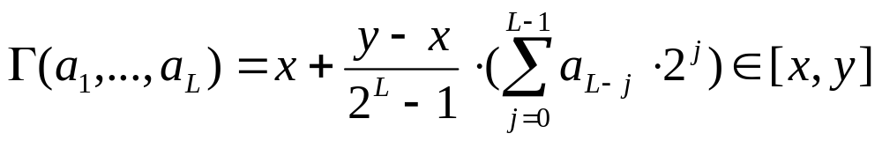
Mapping real values on bit strings
z ∈ [x,y] ⊆ ℜ represented by {a₁,…,a_{L}} ∈ {0,1}^{L}
[x,y] → {0,1}^{L} must be invertible (one phenotype per genotype)
Γ: {0,1}^{L} → [x,y] defines the representation
Only 2^{L} values out of infinite are represented
L determines possible maximum precision of solution
High precision → long chromosomes (slow evolution)

Slide 31
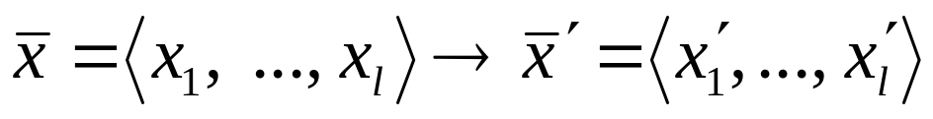
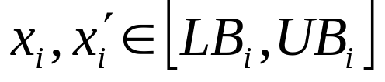
Floating point mutations 1
General scheme of floating point mutations
Uniform mutation:
Analogous to bit-flipping (binary) or random resetting (integers)

Slide 32
Floating point mutations 2
Non-uniform mutations:
  Many methods proposed,such as time-varying range of change etc.
  Most schemes are probabilistic but usually only make a small change to value
  Most common method is to add random deviate to each variable separately, taken from N(0, σ) Gaussian distribution and then curtail to range
  Standard deviation σ controls amount of change (2/3 of deviations will lie in range (- σ to + σ)

Slide 33
Crossover operators for real valued GAs
Discrete:
  each allele value in offspring z comes from one of its parents (x,y) with equal probability: z_{i} = x_{i} or y_{i}
  Could use n-point or uniform
Intermediate
  exploits idea of creating children “between” parents (hence a.k.a. arithmetic recombination)
  z_{i} = α x_{i} + (1 - α) y_{i} where α : 0 ≤ α ≤ 1.
  The parameter α can be:
    constant: uniform arithmetical crossover
    variable (e.g. depend on the age of the population)
    picked at random every time

Slide 34
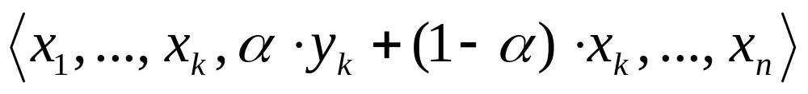
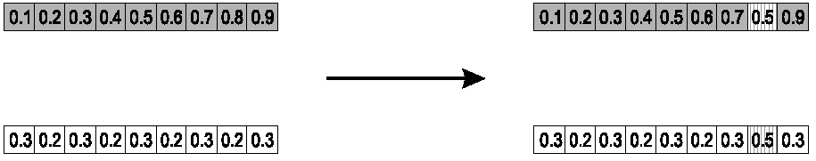
Single arithmetic crossover
Parents: ⟨x₁,…,x_{n} ⟩ and ⟨y₁,…,y_{n}⟩
Pick a single gene (k) at random,
child₁ is:
reverse for other child. e.g. with α = 0.5

Slide 35
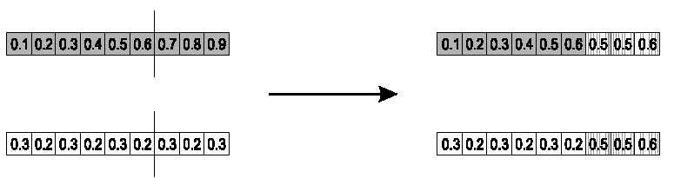
Simple arithmetic crossover
Parents: ⟨x₁,…,x_{n} ⟩ and ⟨y₁,…,y_{n}⟩
Pick random gene (k) after this point mix values
child₁ is:
reverse for other child. e.g. with α = 0.5

Slide 36
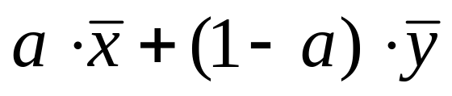
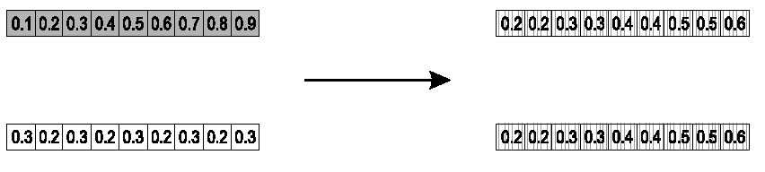
Whole arithmetic crossover
Most commonly used
Parents: ⟨x₁,…,x_{n} ⟩ and ⟨y₁,…,y_{n}⟩
child₁ is:
reverse for other child. e.g. with α = 0.5

Slide 37
Permutation Representations
Ordering/sequencing problems form a special type
Task is (or can be solved by) arranging some objects in a certain order
  Example: sort algorithm: important thing is which elements occur before others (order)
  Example: Travelling Salesman Problem (TSP) : important thing is which elements occur next to each other (adjacency)
These problems are generally expressed as a permutation:
  if there are n variables then the representation is as a list of n integers, each of which occurs exactly once

Slide 38
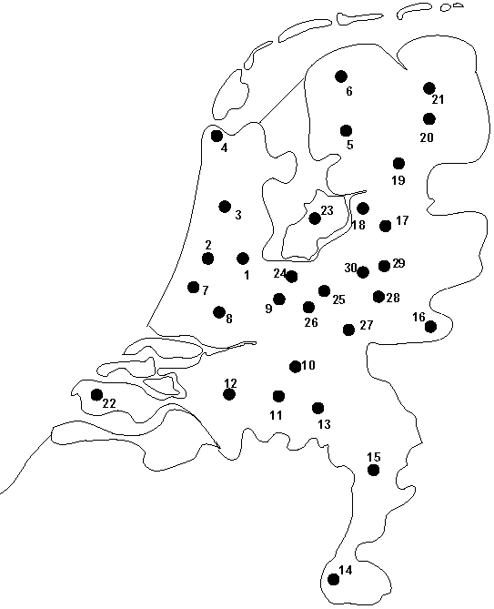
Permutation representation: TSP example
Problem:
  Given n cities
  Find a complete tour with minimal length
Encoding:
  Label the cities 1, 2, … , n
  One complete tour is one permutation (e.g. for n =4 [1,2,3,4], [3,4,2,1] are OK)
Search space is BIG:
for 30 cities there are 30! ≈ 10³² possible tours

Slide 39
Mutation operators for permutations
Normal mutation operators lead to inadmissible solutions
  e.g. bit-wise mutation : let gene i have value j
  changing to some other value k would mean that k occurred twice and j no longer occurred
Therefore must change at least two values
Mutation parameter now reflects the probability that some operator is applied once to the whole string, rather than individually in each position

Slide 40
Insert Mutation for permutations
Pick two allele values at random
Move the second to follow the first, shifting the rest along to accommodate
Note that this preserves most of the order and the adjacency information

Slide 41
Swap mutation for permutations
Pick two alleles at random and swap their positions
Preserves most of adjacency information (4 links broken), disrupts order more

Slide 42
Inversion mutation for permutations
Pick two alleles at random and then invert the substring between them.
Preserves most adjacency information (only breaks two links) but disruptive of order information

Slide 43
Scramble mutation for permutations
Pick a subset of genes at random
Randomly rearrange the alleles in those positions
(note subset does not have to be contiguous)

Slide 44
Crossover operators for permutations
“Normal” crossover operators will often lead to inadmissible solutions
Many specialised operators have been devised which focus on combining order or adjacency information from the two parents
1 2 3 4 5
1 2 3 2 1
5 4 3 2 1
5 4 3 4 5

Slide 45
Order 1 crossover
Idea is to preserve relative order that elements occur
Informal procedure:
  1. Choose an arbitrary part from the first parent
  2. Copy this part to the first child
  3. Copy the numbers that are not in the first part, to the first child:
    starting right from cut point of the copied part,
    using the order of the second parent
    and wrapping around at the end
  4. Analogous for the second child, with parent roles reversed

Slide 46
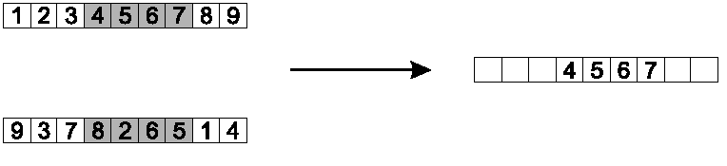
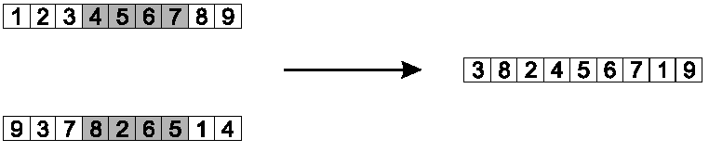
Order 1 crossover example
Copy randomly selected set from first parent
Copy rest from second parent in order 1,9,3,8,2

Slide 47
Partially Mapped Crossover (PMX)
Informal procedure for parents P1 and P2:
Choose random segment and copy it from P1
Starting from the first crossover point look for elements in that segment of P2 that have not been copied
For each of these i look in the offspring to see what element j has been copied in its place from P1
Place i into the position occupied j in P2, since we know that we will not be putting j there (as is already in offspring)
If the place occupied by j in P2 has already been filled in the offspring k, put i in the position occupied by k in P2
Having dealt with the elements from the crossover segment, the rest of the offspring can be filled from P2.
Second child is created analogously

Slide 48
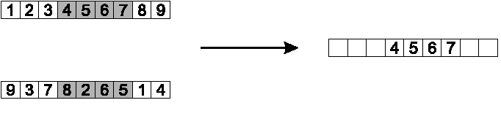
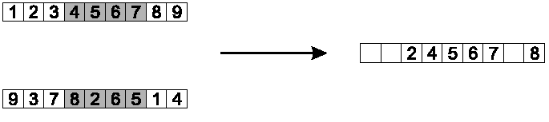
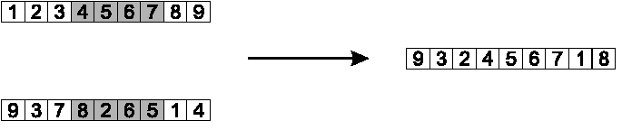
PMX example
Step 1
Step 2
Step 3

Slide 49
Cycle crossover
Basic idea:
Each allele comes from one parent together with its position.
Informal procedure:
1. Make a cycle of alleles from P1 in the following way.
  (a) Start with the first allele of P1.
  (b) Look at the allele at the same position in P2.
  (c) Go to the position with the same allele in P1.
  (d) Add this allele to the cycle.
  (e) Repeat step b through d until you arrive at the first allele of P1.
2. Put the alleles of the cycle in the first child on the positions they have in the first parent.
3. Take next cycle from second parent

Slide 50
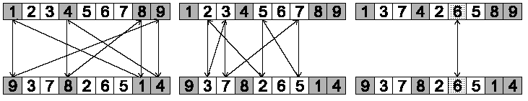
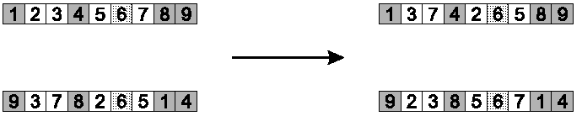
Cycle crossover example
Step 1: identify cycles
Step 2: copy alternate cycles into offspring

Slide 51
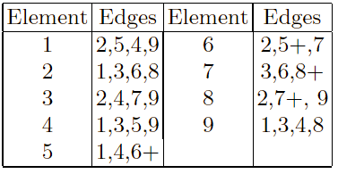
Edge Recombination
Works by constructing a table listing which edges are present in the two parents, if an edge is common to both, mark with a +
e.g. [1 2 3 4 5 6 7 8 9] and [9 3 7 8 2 6 5 1 4]

Slide 52
Edge Recombination 2
Informal procedure once edge table is constructed
1. Pick an initial element at random and put it in the offspring
2. Set the variable current element = entry
3. Remove all references to current element from the table
4. Examine list for current element:
  If there is a common edge, pick that to be next element
  Otherwise pick the entry in the list which itself has the shortest list
  Ties are split at random
5. In the case of reaching an empty list:
  Examine the other end of the offspring is for extension
  Otherwise a new element is chosen at random

Slide 53
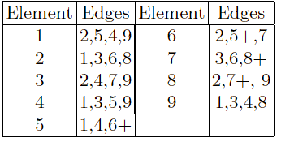
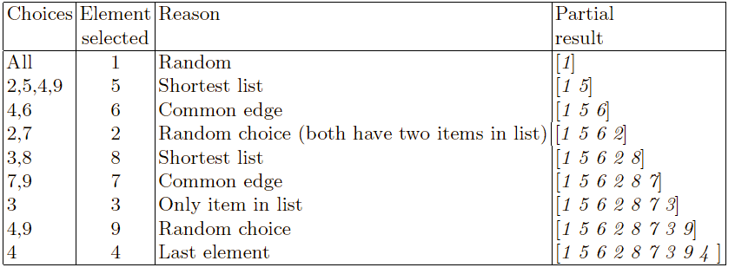
Edge Recombination example

Slide 54
Multiparent recombination
Recall that we are not constricted by the practicalities of nature
Noting that mutation uses 1 parent, and “traditional” crossover 2, the extension to a>2 is natural to examine
Been around since 1960s, still rare but studies indicate useful
Three main types:
  Based on allele frequencies, e.g., p-sexual voting generalising uniform crossover
  Based on segmentation and recombination of the parents, e.g., diagonal crossover generalising n-point crossover
  Based on numerical operations on real-valued alleles, e.g., center of mass crossover, generalising arithmetic recombination operators

Slide 55
Population Models
SGA uses a Generational model:
  each individual survives for exactly one generation
  the entire set of parents is replaced by the offspring
At the other end of the scale are Steady-State models:
  one offspring is generated per generation,
  one member of population replaced,
Generation Gap
  the proportion of the population replaced
  1.0 for GGA, 1/pop_size for SSGA

Slide 56
Fitness Based Competition
Selection can occur in two places:
  Selection from current generation to take part in mating (parent selection)
  Selection from parents + offspring to go into next generation (survivor selection)
Selection operators work on whole individual
  i.e. they are representation-independent
Distinction between selection
  operators: define selection probabilities
  algorithms: define how probabilities are implemented

Slide 57
Implementation example: SGA
Expected number of copies of an individual i
E( n_{i} ) = μ • f(i)/ ⟨f⟩
(μ = pop.size, f(i) = fitness of i, ⟨f⟩ avg. fitness in pop.)
Roulette wheel algorithm:
  Given a probability distribution, spin a 1-armed wheel n times to make n selections
  No guarantees on actual value of n_{i}
Baker’s SUS algorithm:
  n evenly spaced arms on wheel and spin once
  Guarantees floor(E( n_{i} ) ) ≤ n_{i} ≤ ceil(E( n_{i} ) )

Slide 58
Fitness-Proportionate Selection
Problems include
  One highly fit member can rapidly take over if rest of population is much less fit: Premature Convergence
  At end of runs when fitnesses are similar, lose selection pressure
  Highly susceptible to function transposition
Scaling can fix last two problems
  Windowing: f’(i) = f(i) - β ^{t}
    where β is worst fitness in this (last n) generations
  Sigma Scaling: f’(i) = max( f(i) – (⟨ f ⟩ - c • σ_{f} ), 0.0)
    where c is a constant, usually 2.0

Slide 59
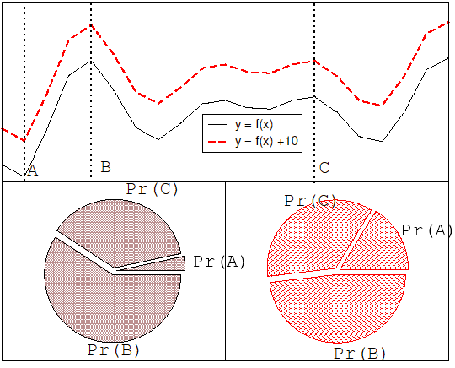
Function transposition for FPS

Slide 60
Rank – Based Selection
Attempt to remove problems of FPS by basing selection probabilities on relative rather than absolute fitness
Rank population according to fitness and then base selection probabilities on rank where fittest has rank μ and worst rank 1
This imposes a sorting overhead on the algorithm, but this is usually negligible compared to the fitness evaluation time

Slide 61
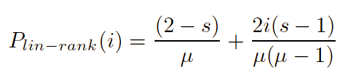
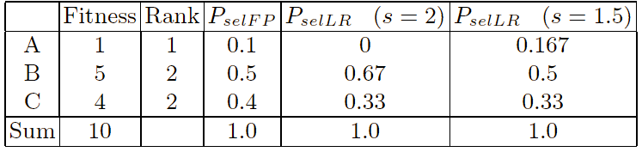
Linear Ranking
Parameterised by factor s: 1.0 < s ≤ 2.0
  measures advantage of best individual
  in GGA this is the number of children allotted to it
Simple 3 member example

Slide 62
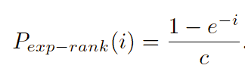
Exponential Ranking
Linear Ranking is limited to selection pressure
Exponential Ranking can allocate more than 2 copies to fittest individual
Normalise constant factor c according to population size

Slide 63
Tournament Selection
All methods above rely on global population statistics
  Could be a bottleneck esp. on parallel machines
  Relies on presence of external fitness function which might not exist: e.g. evolving game players
Informal Procedure:
  Pick k members at random then select the best of these
  Repeat to select more individuals

Slide 64
Tournament Selection 2
Probability of selecting i will depend on:
  Rank of i
  Size of sample k
    higher k increases selection pressure
  Whether contestants are picked with replacement
    Picking without replacement increases selection pressure
  Whether fittest contestant always wins (deterministic) or this happens with probability p
For k = 2, time for fittest individual to take over population is the same as linear ranking with s = 2 • p

Slide 65
Survivor Selection
Most of methods above used for parent selection
Survivor selection can be divided into two approaches:
  Age-Based Selection
    e.g. SGA
    In SSGA can implement as “delete-random” (not recommended) or as first-in-first-out (a.k.a. delete-oldest)
  Fitness-Based Selection
    Using one of the methods above or

Slide 66
Two Special Cases
Elitism
  Widely used in both population models (GGA, SSGA)
  Always keep at least one copy of the fittest solution so far
GENITOR: a.k.a. “delete-worst”
  From Whitley’s original Steady-State algorithm (he also used linear ranking for parent selection)
  Rapid takeover : use with large populations or “no duplicates” policy

Slide 67
Example application of order based GAs: JSSP
Precedence constrained job shop scheduling problem
J is a set of jobs.
O is a set of operations
M is a set of machines
Able ⊆ O × M defines which machines can perform which operations
Pre ⊆ O × O defines which operation should precede which
Dur : ⊆ O × M → IR defines the duration of o ∈ O on m ∈ M
The goal is now to find a schedule that is:
Complete: all jobs are scheduled
Correct: all conditions defined by Able and Pre are satisfied
Optimal: the total duration of the schedule is minimal

Slide 68
Precedence constrained job shop scheduling GA
Representation: individuals are permutations of operations
Permutations are decoded to schedules by a decoding procedure
  take the first (next) operation from the individual
  look up its machine (here we assume there is only one)
  assign the earliest possible starting time on this machine, subject to
    machine occupation
    precedence relations holding for this operation in the schedule created so far
fitness of a permutation is the duration of the corresponding schedule (to be minimized)
use any suitable mutation and crossover
use roulette wheel parent selection on inverse fitness
Generational GA model for survivor selection
use random initialisation

Slide 69
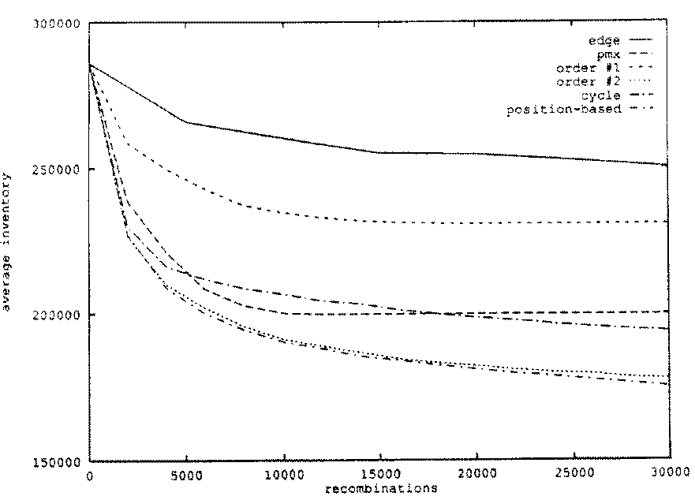
JSSP example: operator comparison

